Slide 1

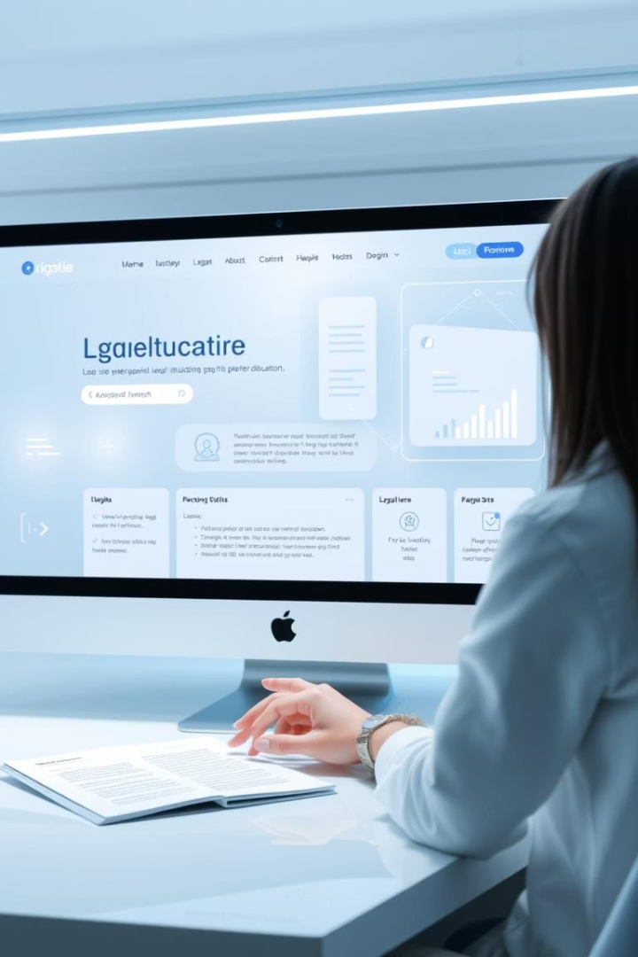
Vision-Enhanced Gamified Platforms for Skill Development and Legal Literacy
LegalEduScan is an innovative web-based platform designed to revolutionize legal education by combining Artificial Intelligence, NLP, and gamification. It aims to empower law students and legal professionals to efficiently analyze legal documents by automating classification, clause extraction, and quiz generation. This immersive system offers a comprehensive dashboard, XP rewards, and achievements to enhance engagement and promote continual learning in legal literacy and contract review skills.
Notes:
1

Slide 2
Document Upload and OCR Extraction
Seamless Document Input
Extraction Accuracy
Users can upload various scanned legal documents such as PDFs and images. The platform leverages OCR technology, combining Tesseract and OpenCV, to transform these scans into machine-readable text ready for analysis. This foundational step ensures even handwritten or poorly formatted contracts become accessible for AI processing.
Advanced image preprocessing improves text recognition accuracy by correcting skew and noise. This enables precise extraction of legal content, providing a clean textual dataset for subsequent AI-based classification and clause identification.
Notes:
2

Slide 3
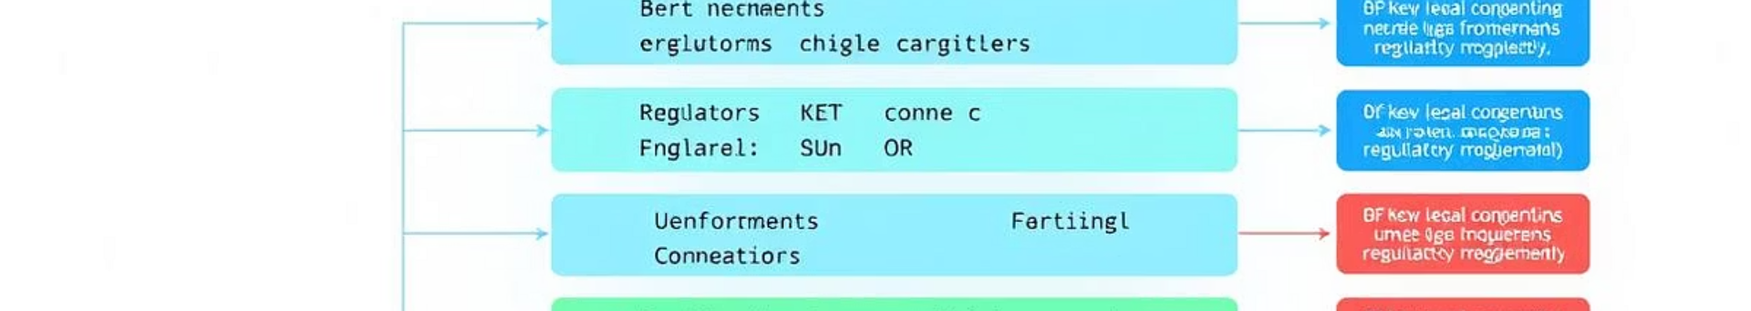



AI-Driven Text Analysis with Transformers
Document Classification
Named Entity Recognition
Question Answering
Uses BertForSequenceClassification to automatically identify the type or category of legal documents, such as contracts, agreements, or memoranda.
BertForTokenClassification highlights key legal entities including organizations, individuals, and locations, enhancing comprehension of complex documents.
The BertForQuestionAnswering model enables users to ask specific questions about clauses, such as termination terms, facilitating quick access to precise information.
Notes:
3

Slide 4




Clause Extraction and Quiz Generation
Quiz Generation
Clause Extraction
Automatically generates multiple-choice quizzes based on extracted clauses. Each quiz tests comprehension by offering the correct clause against distractors.
Regex patterns identify critical clauses like Termination, Indemnity, and Governing Law, enabling efficient retrieval of essential legal terms.
Notes:
4

Slide 5

Cloud Integration and User Progress
Data Storage
Progress Tracking
Uses Firebase Firestore to securely store document scans, user activities, quizzes, and XP, ensuring data persistence and accessibility.
User progress is tracked and rewarded. The XP system incentivizes learning by awarding points for completed scans and quizzes, encouraging continuous engagement.
Notes:
5

Slide 6
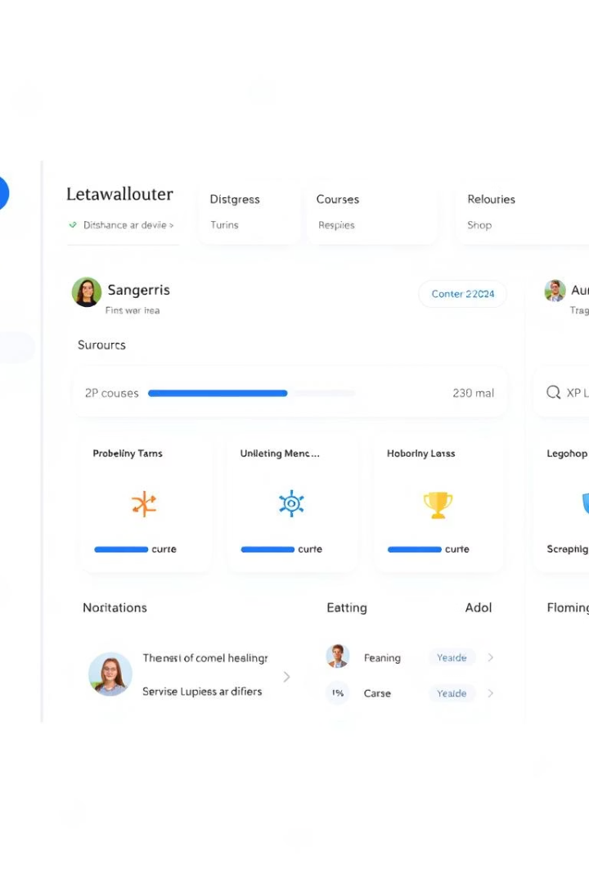

Dashboard and Gamification Elements
Performance Metrics
Achievements & Rewards
Dashboard.html visualizes current level, XP points, quiz statistics, and recent activity history to motivate users.
Visual progress bars and achievement badges enhance user motivation and provide tangible milestones in skill development.
Leaderboard
The leaderboard ranks users based on XP and accomplishments, fostering healthy competition and social learning.
Notes:
6

Slide 7
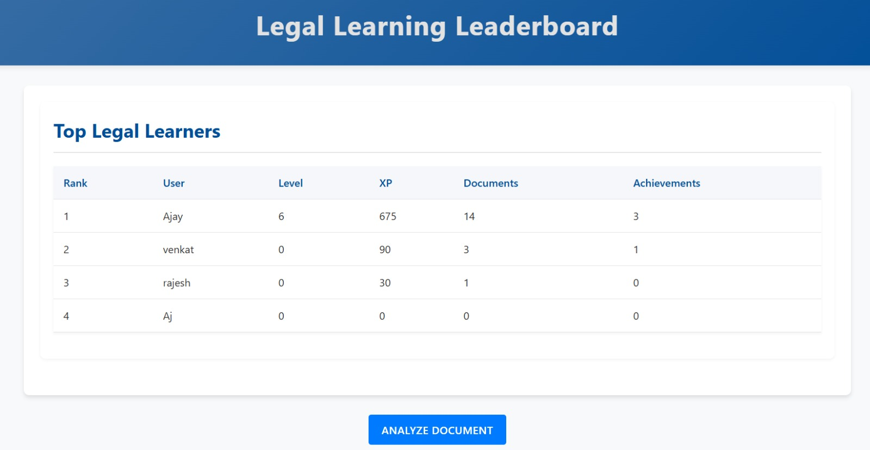
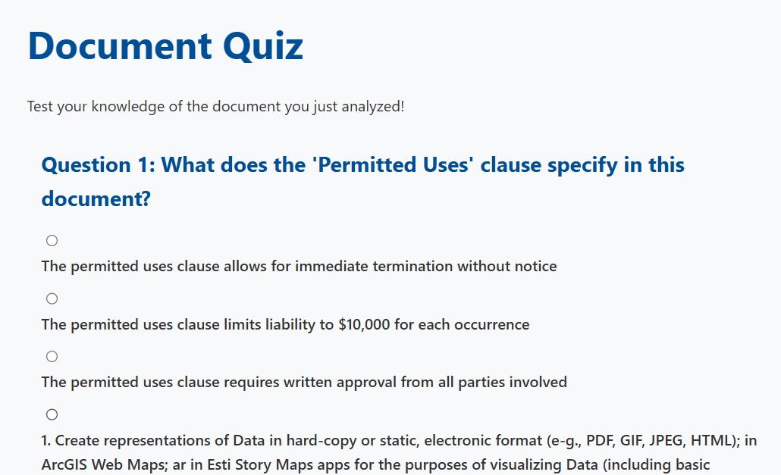
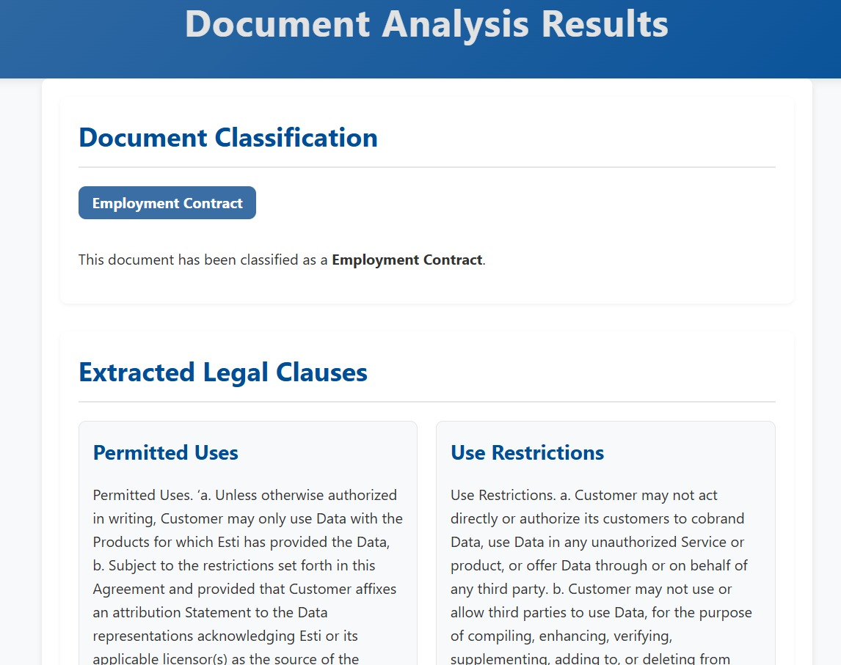
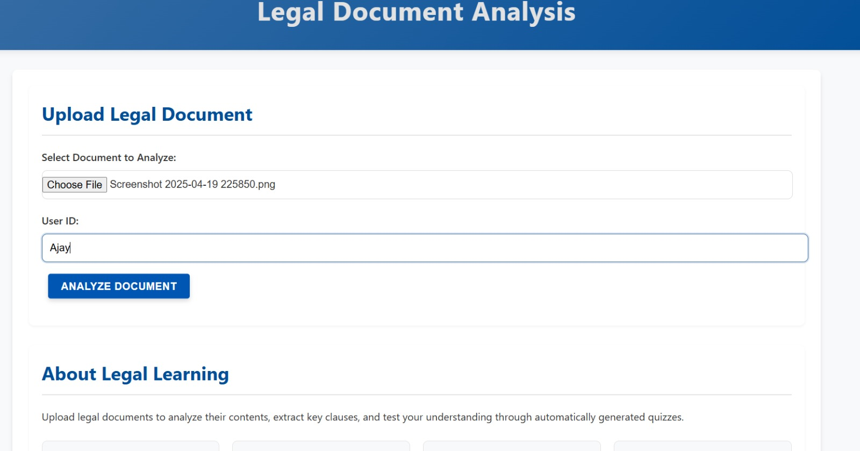
Notes:
7

Slide 8
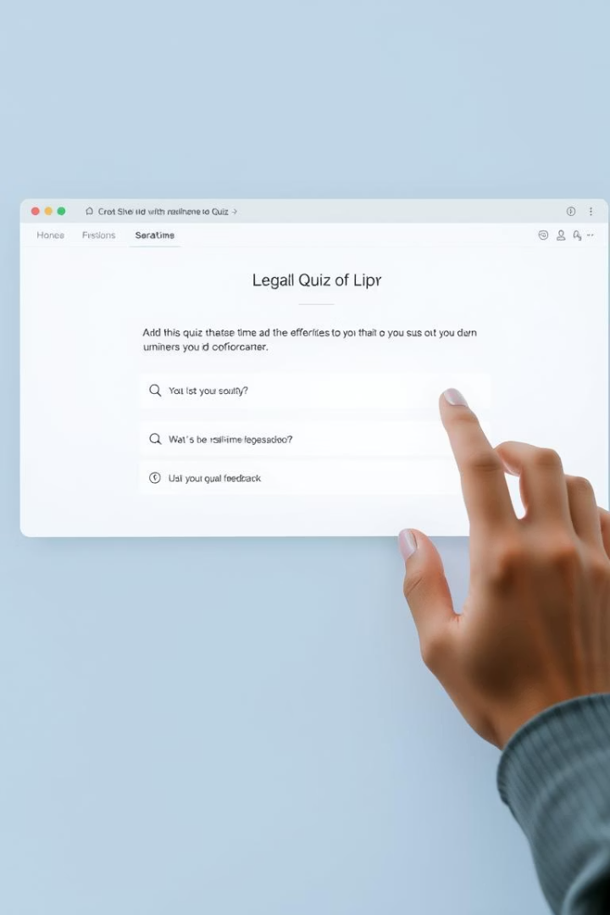
Interactive Quiz UI and Feedback
Quiz Presentation
quiz.html offers an intuitive interface for answering quizzes generated from document clauses.
Evaluation and Results
quiz_results.html delivers immediate feedback with scores, XP earned, and personalized tips to reinforce learning.
Continuous Improvement
Feedback helps users identify strengths and areas for improvement, promoting targeted study and skill enhancement.
Notes:
8

Slide 9
Technology Stack and Future Extensions
Current Technologies
Research & Future Enhancements
Frontend: HTML, CSS, Jinja2 Templates
Fine-tuning BERT on legal corpora for greater accuracy
Backend: Python, Flask, Torch AI/NLP
AI Models: BERT for classification, NER, QA
Expanding clause types to cover arbitration and liability
OCR: Tesseract, OpenCV
Database: Firebase Firestore
Adaptive quizzes leveraging Bloom’s Taxonomy
Voice-based Q&A and AR immersive experiences
Notes:
9

Slide 10
Thank You
Notes:
10

